Slide 1
Chapter Four
While Loop, For loop, range of integers, random numbers

Slide 2
The while Loop

Slide 3
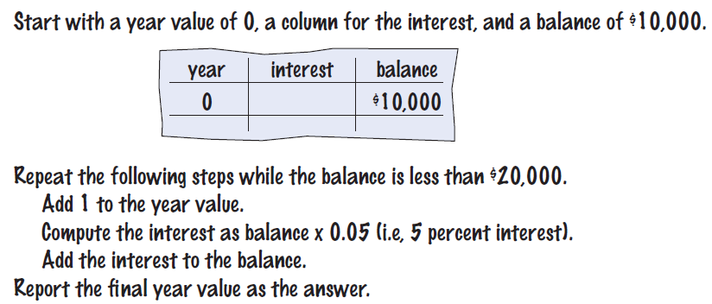
The while Loop
Examples of loop applications
Calculating compound interest
Simulations, event driven programs
Drawing tiles…
Compound interest algorithm
Steps

Slide 4
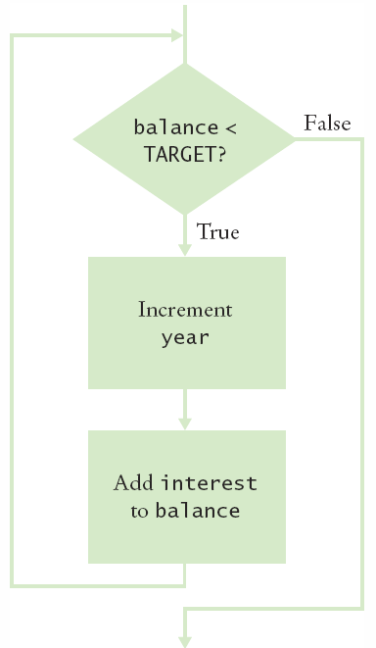
Planning the while Loop
balance = 10.0
target = 100.0
year = 0
rate = 0.025
while balance < TARGET :
year = year + 1
interest = balance * RATE/100
balance = balance + interest
A loop executes instructions repeatedly while a condition is True.

Slide 5
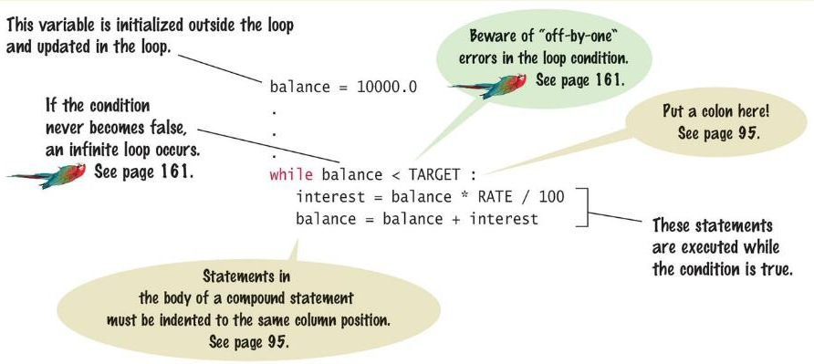
Syntax: while Statement

Slide 6
Counter Controlled Loops
A while loop that is controlled by a counter
In order to loop the correct number of times, the while loop must contain all 3 statements:
Initialize: before the loop
Test: the loop condition
Update: inside the loop body
counter = 1 # Initialize counter
while counter <= 10 : # Check or test counter
print(counter)
counter = counter + 1 # Update the counter
.

Slide 7
Event Controlled Loops
A while loop can be controlled by an event
Note that the initialize, test, update statements are all present.
balance = INITIAL_BALANCE # Initialize balance
while balance <= TARGET: # Test balance
year – year + 1
balance = balance * 2 # Update balance

Slide 8
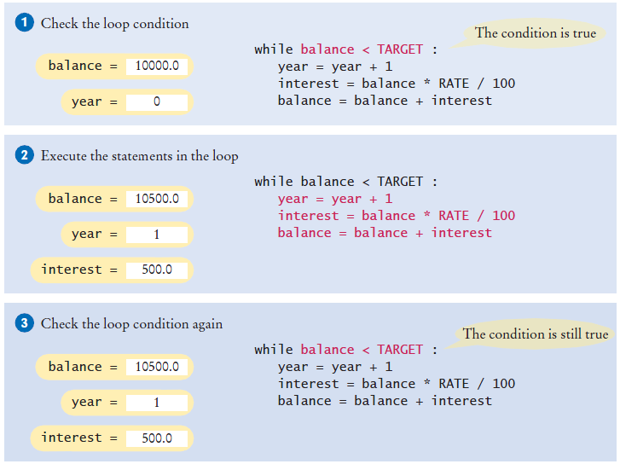
Execution of the Loop

Slide 9
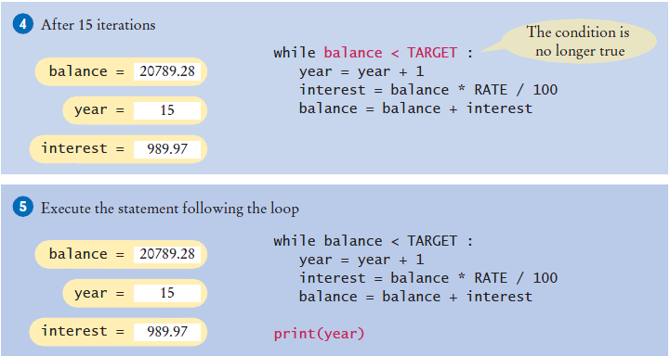
Execution of the Loop (2)

Slide 10
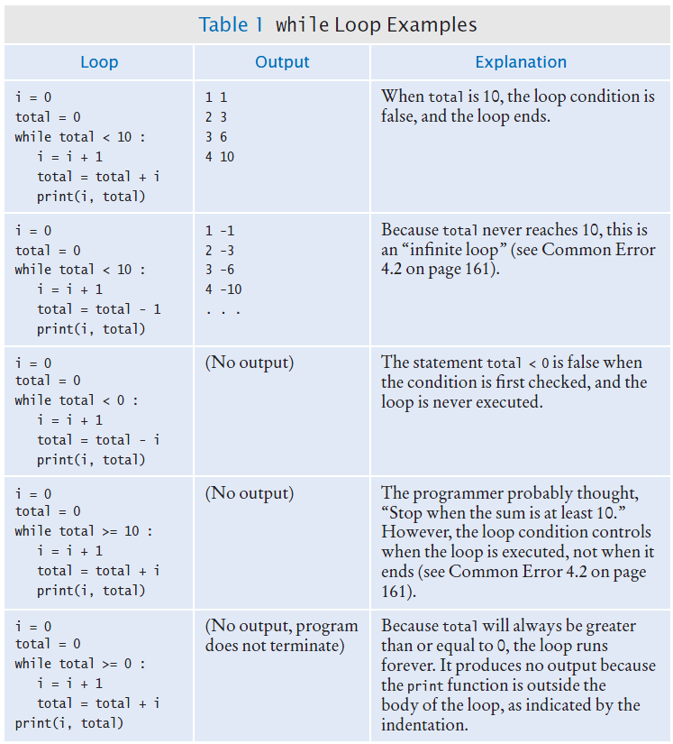
while Loop Examples (1)

Slide 11
while Loop Examples (2)

Slide 12
Common Error: Incorrect Test Condition
The loop body will only execute if the test condition is True.
If bal is initialized as less than the TARGET and should grow until it reaches TARGET
Which version will execute the loop body?
while bal >= TARGET :
year = year + 1
interest = bal * RATE
bal = bal + interest
while bal < TARGET :
year = year + 1
interest = bal * RATE
bal = bal + interest

Slide 13
Common Error: Infinite Loops
The loop body will execute until the test condition becomes False.
What if we forget to update the test variable?
bal is the test variable (TARGET doesn’t change)
The loop will run forever! (or until we stop the program)
Corrected version:
while bal < TARGET :
year = year + 1
interest = bal * RATE
while bal < TARGET :
year = year + 1
interest = bal * RATE

Slide 14
Setting Up a while Loop

Slide 15
Sentinel Values
Sentinel values are used to end a loop.
A sentinel value denotes the end of a data set, but it is not part of the data.
Example: a loop to add up salaries will stop when the salary is 0. The 0 value is the sentinel value.
Sentinel value
salary = 0.0
while salary >= 0 :
salary = float(input())
if salary >= 0.0 :
total = total + salary
count = count + 1

Slide 16
Initializing the Test Variable
The test variable of a while loop is the one used in the loop condition
We must initialize the test variable before the loop.
We can initialize the test variable with a value such that the loop will run at least once:
while salary >= 0 : # The test variable is salary
# Set salary to 0 to ensure that the loop starts to run
salary = 0.0
while salary >= 0 :
Or we can initialize with a read before the loop.
salary = float(input("Enter a salary or -1 to finish: "))
while salary >= 0 :

Slide 17
Updating the Test Variable
The test variable must be updated inside the loop
Here the input operation at the bottom of the loop is used to update the test variable
# initialize the test variable with the first read
salary = float(input("Enter a salary or -1 to finish: "))
while salary >= 0.0 :
total = total + salary
count = count + 1
# update the test variable with subsequent reads
salary = float(input("Enter a salary or -1 to finish: "))

Slide 18
Boolean Variables as Test Variables
A boolean variable can be used to control a loop.
Sometimes called a ‘flag’ variable.
Initialize done so that the loop will execute
done = False
while not done :
value = float(input("Enter salary or -1 to finish: "))
if value < 0.0:
done = True
else :
# Process value
Set done ‘flag’ to True if sentinel value is found, this will stop the loop

Slide 19
Common Loop Algorithms

Slide 20
Average Example
Average of Values
First total the values
Initialize count to 0
Increment per input
Check for count 0
Before divide!
total = 0.0
count = 0
inputStr = input("Enter value: ")
while inputStr != "" :
value = float(inputStr)
total = total + value
count = count + 1
inputStr = input("Enter value: ")
if count > 0 :
average = total / count
else :
average = 0.0

Slide 21
Sum Example
Sum of Values or Running Sum:
Initialize total to 0
Use while loop with sentinel
total = 0.0
inputStr = input("Enter value: ")
while inputStr != "" :
value = float(inputStr)
total = total + value
inputStr = input("Enter value: ")

Slide 22
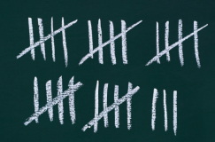
Counting Matches
Counting Matches
Initialize negatives to 0
Use a while loop
Add to negatives per match
negatives = 0
inputStr = input("Enter value: ")
while inputStr != "“ :
value = int(inputStr)
if value < 0 :
negatives = negatives + 1
inputStr = input("Enter value: ")
print("There were", negatives, "negative values.")

Slide 23
Prompt Until a Match is Found
Initialize boolean flag to False
Test sentinel in while loop
Get input, and compare to range
If input is in range, change flag to True
Loop will stop executing
valid = False
while not valid :
value = int(input("Please enter a positive value < 100: "))
if value > 0 and value < 100 :
valid = True
else :
print("Invalid input.")
This is an excellent way to validate user provided inputs

Slide 24
Maximum
Get first input value
By definition, this is the largest that we have so far
Loop while we have a valid number (non-sentinel)
Get another input value
Compare new input to largest
Update largest if necessary
largest = int(input("Enter a value: "))
inputStr = input("Enter a value: ")
while inputStr != "“ :
value = int(inputStr)
if value > largest :
largest = value
inputStr = input("Enter a value: ")

Slide 25
Minimum
Get first input value
This is the smallest that we have so far.
Loop while we have a valid number (non-sentinel)
Get another input value
Compare new input to smallest
Update smallest if necessary
smallest = int(input("Enter a value: "))
inputStr = input("Enter a value: ")
while inputStr != "“ :
value = int(inputStr)
if value < smallest :
smallest = value
inputStr = input("Enter a value: ")

Slide 26
Comparing Adjacent Values
Get first input value
Use while to determine if there are more to check
Copy input to previous variable
Get next value into input variable
Compare input to previous, and output if same
value = int(input("Enter a value: "))
inputStr = input("Enter a value: ")
while inputStr != "“ :
previous = value
value = int(inputStr)
if value == previous :
print("Duplicate input")
inputStr = input("Enter a value: ")

Slide 27
The for Loop

Slide 28
The for Loop
Uses of a for loop:
The for loop can be used to iterate over (or walk through) the contents of any sequence of data.
So far we’ve worked with a data type which is a sequence of data: a string that stores a sequence of multiple characters.

Slide 29
Cases for using a for Loop (1)
When working with a sequence of data such as a string, a for loop can make the code shorter.
Note an important difference between the while loop and the for loop.
In the while loop, the index variable i is assigned 0, 1, and so on.
In the for loop, the element variable is assigned stateName[0], stateName[1], and so on.
stateName = "Virginia"
i = 0
while i < len(stateName) :
letter = stateName[i]
print(letter)
i = i + 1
while version
stateName = "Virginia"
for letter in stateName :
print(letter)
for version

Slide 30
Example of a for Loop (2)
Another example of using a for loop for iterating over a sequence of integers:
i = 1
while i < 10 :
print(i)
i = i + 1
while version
for i in range(1, 10) :
print(i)
for version

Slide 31
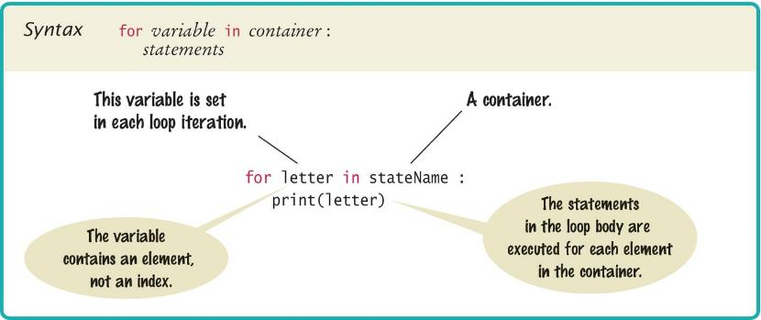
Syntax of a for Statement
Using a for loop to iterate over the contents of a sequence, one element at a time.

Slide 32
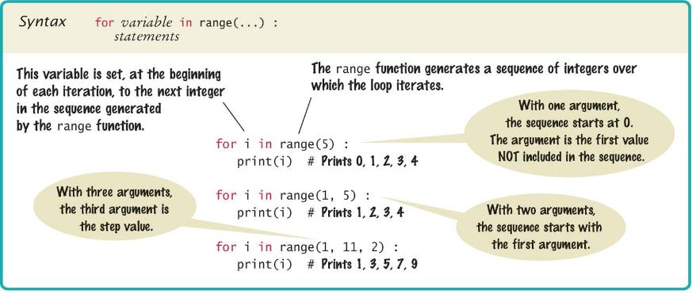
The range Function
The range function returns a sequence of integers.
The range of the integers is specified by the input arguments to the range function.

Slide 33
The range Function and for Loops
Examples of using the range function with for loops
for loop | Values of i | Comment
for i in range(6) : | 0, 1, 2, 3, 4, 5 | i value starts at 0 by default, and goes up to but not including 6
for i in range(10,15) : | 10, 11, 12, 13, 14 | i value starts at 10
for i in range(10, 15, 2) : | 10, 12, 14 | i values step up by 2
for i in range(6, 0, -1) : | 6, 5, 4, 3, 2, 1 | i values step down by 1

Slide 34
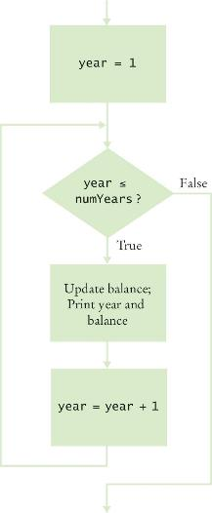
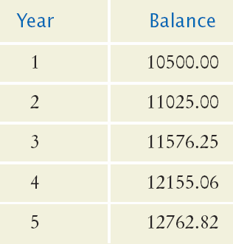

Planning a for Loop
Print the balance at the end of each year for a number of years

Slide 35
Steps to Writing a Loop
Decide what task needs to be repeated
Write the block of code to do the task one time
Indent the block of code to turn it into the loop body
Specify the loop condition
Is it an event controlled loop or counter controlled loop?
What is the test variable (a number, a user input…)?
What is the start value and end value of the test variable?
Determine loop type
while loop or for loop?
Write the loop condition that uses the test variable.
This is the test statement for the loop
Verify that there is an initialize statement and an update statement for the test variable.
Trace the loop with some example data.

Slide 36
The print Function in a Loop
When the print function runs, it automatically appends a newline to the text that’s being printed.
When we use print inside a loop, the newline causes multiple output lines of text, depending on how many iterations the loop runs.
If we want to use print inside a loop body but we want all output to be on a single line, we can use the special argument: end=""
Example:
The argument end has a default value of ‘\n’ or newline. When we assign "" (or empty string) to end, we tell the print function to end the printing with nothing.
print("00", end="")
print(3 + 4) # output: 007

Slide 37
Nested Loops

Slide 38
Loops Inside of Loops
In Chapter Three we learned how to nest if statements to allow us to make complex decisions
Remember that to nest the if statements we need to indent the code block
Complex problems sometimes require a nested loop, one loop nested inside another loop
The nested loop will be indented inside the code block of the first loop
A good example of using nested loops is when we are processing cells in a table:
The outer loop iterates over all of the rows in the table
The inner loop processes the columns in the current row

Slide 39
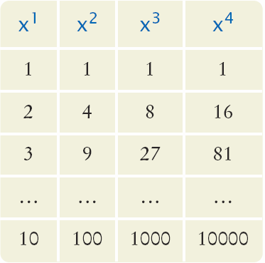
Example Problem Statement
Print a Table Header that contains x¹, x², x³, and x⁴
Print a Table with four columns and ten rows that contain the powers of x¹, x², x³, and x⁴ for x = 1 to 10

Slide 40
Applying Nested Loops
To print a table with rows and columns:
Print top line (header)
Use a for loop
Print table body…
Determine the number of rows
Determine the number of columns
Write a loop for each row
Write a loop for each column
In our example there are:
Four columns in the table
Ten rows in the table

Slide 41
Pseudocode to Print the Table
To print the table
for x from 1 to 10
print a row
print a new line
To print a row
for n from 1 to 4
print x^{n}
We have to place the loop to print a row inside the loop to prin the table.
The inner loop is “nested” inside the outer loop

Slide 42
Pseudocode to Print the Table
Print the table header (the header line is blue in the table shown)
for col from 1 to 4
print a column header
print a new line
Print the table
for row from 1 to 10
for col from 1 to 4
print row^{col}
print a new line
Note that we take advantage of the incrementing row value (which is from 1 to 10) and incrementing col value (which is 1 to 4) in order to calculate the output to print.
col ➔
row
⬇

Slide 43
Flowchart of a Nested Loop
row = 1
row
<= 10
True
col= 1
Inner Loop
False
col <= 4?
True
Print row^{col}
False
col = col + 1
Print new line
row = row+1
Done

Slide 44
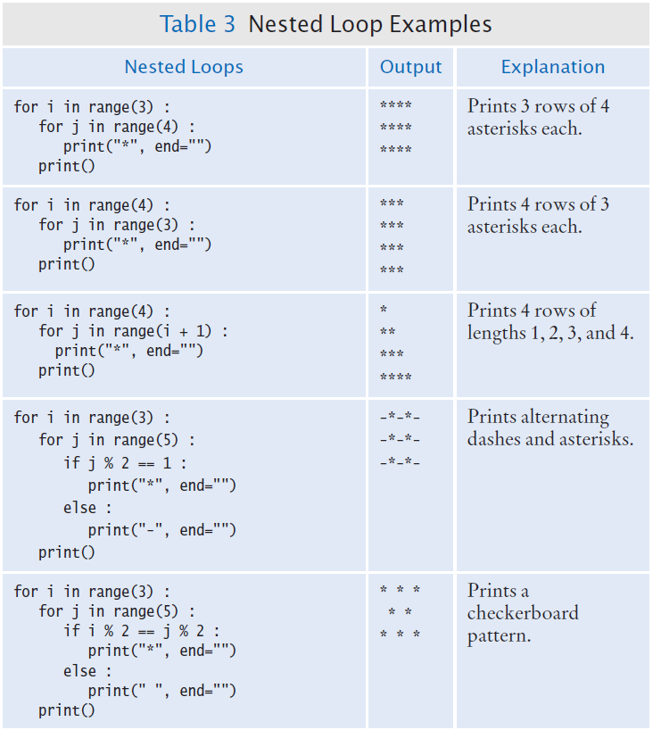
Nested Loop Examples

Slide 45
Hand Tracing the Loop
Given the last nested loops in the previous table:
i values are: 0, 1, 2, 3 – So we will have four lines of stars
j values are:
0 - So we will have one star
0, 1 - So we will have two stars
0, 1, 2 - So we will have three stars
0, 1, 2, 3 - So we will have four stars

Slide 46
Nested Loop Examples (2)

Slide 47
Processing Strings

Slide 48
Counting Matches
Suppose we need to count the number of uppercase letters contained in a string.
We can use a for loop to check each character in the string to see if it is uppercase.
The loop below sets the variable char equal to each successive character in the string.
Each pass through the loop tests the next character in the string to see if it is uppercase
uppercase = 0
for char in string :
if char.isupper() :
uppercase = uppercase + 1

Slide 49
Counting Vowels
Suppose we need to count the vowels within a string.
We can use a for loop to check each character in the string to see if it is in the string of vowels “aeiuo”.
The loop below sets the variable char equal to each successive character in the string.
Each pass through the loop tests the lower case of the next character in the string to see if it is in the string “aeiou”.
vowels = 0
for char in word :
if char.lower() in "aeiou" :
vowels = vowels + 1

Slide 50
Finding All Matches Example
When we need to examine every character in a string, we can use a for loop to examine each character.
If we need to print the position of each uppercase letter in a sentence we can test each character in the string and print the position of all uppercase characters
We set the range to be the length of the string
We test each character
If it is uppercase we print i, its position in the string
sentence = input("Enter a sentence: ")
for i in range(len(sentence)) :
if sentence[i].isupper() :
print(i)

Slide 51
Finding the First Match
This example finds the position of the first digit in a string.
found = False
position = 0
while not found and position < len(string) :
if string[position].isdigit() :
found = True
else :
position = position + 1
if found :
print("First digit occurs at position", position)
else :
print("The string does not contain a digit.")

Slide 52
Finding the Last Match
Here is a loop that finds the position of the last digit in the string.
This approach uses a while loop to start at the last character in a string and test each value moving from the end of the string to the start of the string
Position is set to the length of the string - 1
If the character is not a digit, we decrease position by 1
Until we find a digit, or process all the characters
found = False
position = len(string) - 1
while not found and position >= 0 :
if string[position].isdigit() :
found = True
else :
position = position - 1

Slide 53
Control Flow Statements

Slide 54
The break statement
A break statement is used to break out of a loop or to end the loop when a condition occurs.
The loop condition seems to indicate that the loop will run 10 times but the break statement causes the loop to end when n becomes 6.
The break statement can cause code to be difficult to read and maintain because, as seen in the above example, the loop actually runs fewer times than the loop condition shows.
The code above is clearer if a more precise loop condition is used:
for n in range(10) :
print(n) if n > 5 :
break
for n in range(7) :
print(n)

Slide 55
Use Proper Loop Control
A break statement should be avoided if there is a clear condition or conditions to terminate the loop.
It’s hard to see when this loop Much easier to see this loop will stop: condition:
Generally when loops have a terminating condition then there’s no need to use the break statement.
The break statement is best used to break out of an infinite loop, such as when we write code for a server that needs to run indefinitely.
num = int(input(“Number: ”)
while True :
if num < 0 : break
if num >= 100 :
break
# do something
num = int(input(“Number: ”)
while 0 < num < 100 :
# do something

Slide 56
The continue statement
The continue statement causes execution to stop the current iteration of the loop and go to the next iteration.
The code prints all numbers from 1 to 99, but not numbers that are multiples of 7.
The continue statement is typically used to skip over certain iterations of the loop.
num = 0
while num < 100 :
num += 1
if num % 7 == 0 :
continue # stop current iteration and go back to
# to the while statement
else :
print(num)

Slide 57
Random Numbers

Slide 58
Random Numbers
Games often use random numbers to make things interesting:
Rolling Dice
Spinning a wheel
Pick a card
A simulation usually involves looping through a sequence of events
Days
Events

Slide 59
Generating Random Integers
Python has a pseudo-random number generator that produces numbers that appear to be random
The numbers are not completely random. They are drawn from a sequence of numbers that does not repeat for a long time.
First the random Python module is imported:
Then the seed for the random generator is produced:
The seed function is called one time in the program to initialize the random generator.
Then random integer can be fetched:
where min <= num <= max
from random import randint, seed
seed()
num = randint(min, max)

Slide 60
End of Chapter 4 Notes

